Slide 1
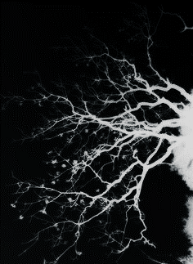
Stress and Our Neurons
Jess Hoynoski

Slide 2
Stress
Definition:
a state of mental or emotional strain or tension resulting from adverse or very demanding circumstances
What are common stressors?
Work
School
Family
Relationships with others

Slide 3
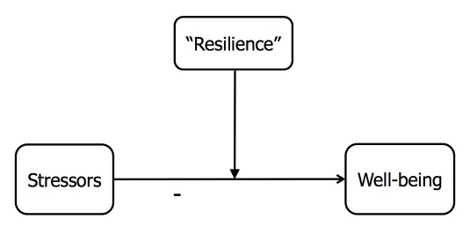
Resilience

Slide 4
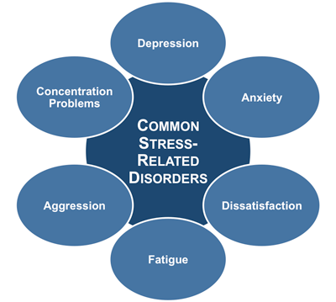
Disorders or Diseases

Slide 5
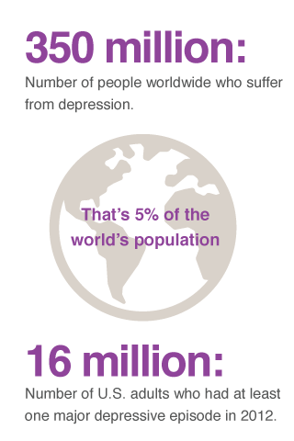
Depression
A mental health disorder characterized by persistently depressed mood or loss of interest in activities, causing significant impairment in daily life
Causes:
Sudden change
Genetics
Abnormal neural circuits
Statistics have not changed since 2012

Slide 6
Depressive Behaviors
Agitation
Irritability
Social isolation

Slide 7
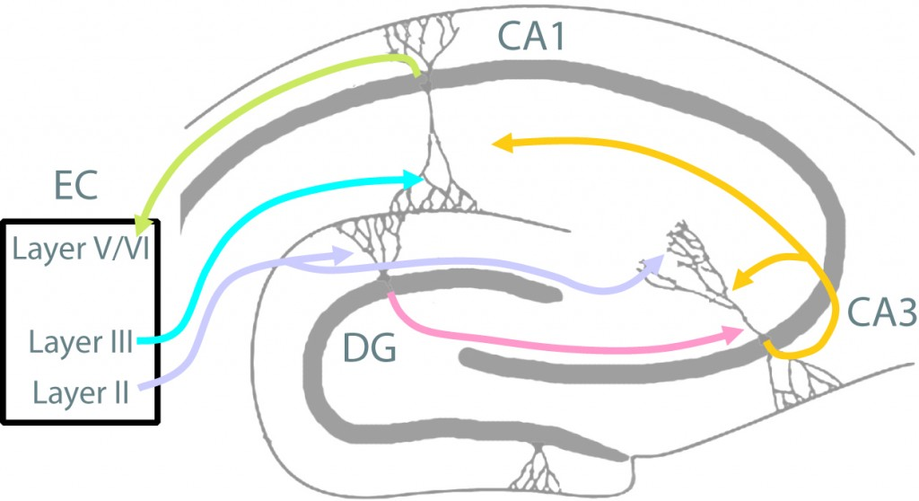
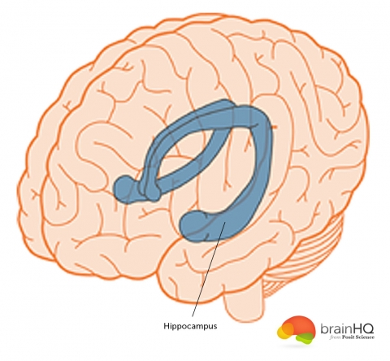
Hippocampus
Part of the limbic system
Crucial for episodic and spatial memory
Assists in emotional regulation
Participates in spatial navigation

Slide 8
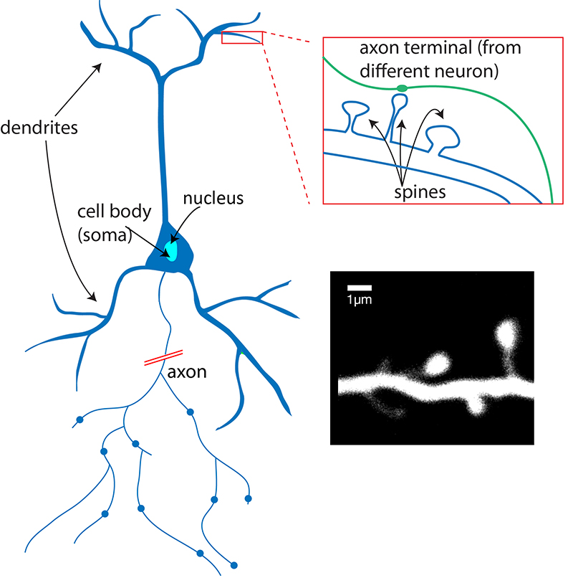
Neuron Structure

Slide 9
Why Should We Care?
Everyone suffers from stress
Most people have suffered, are currently suffering, will suffer, or know someone who is suffering from depression
Since stress and depression affect everyone to some extent, shouldn’t we know what it does to our neurons?
Notes:
Neurons = function

Slide 10
My Questions
What effects do depression and stress have on our neurons?
Is there a difference in these effects if familial separation is the stressor?
If there is a difference, is there a way to counteract it?

Slide 11
Iñiguez, S. et al. (2016) Social defeat stress induces depression-like behavior and alters spine morphology in the hippocampus of adolescent male C57BL/6 mice

Slide 12
Methods
55 male, postnatal day (PD) 35, C57BL/6
C57BL/6 mice were housed with littermates in groups of 3-4
Social Defeat
10 minute sessions every day for 10 days
Housed next to their CD1 aggressor (same cage, just other side of the divider)
Social interaction test
First trial empty cage
Second trial novel CB1
Tail suspension test

Slide 13
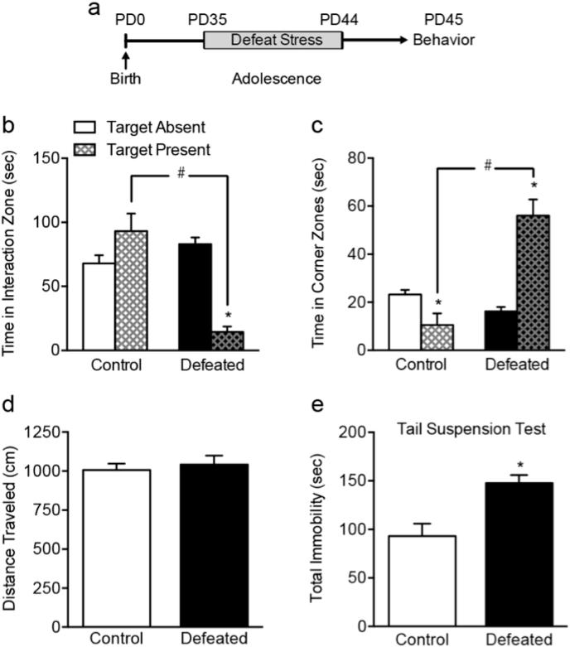
Figure 1 Social defeat stress induces a depression-like behavioral response in adolescent C57BL/6 male mice
Notes:
(A) Timeline of the experimental procedures. Adolescent (postnatal day [PD]) 35 mice were exposed to 10 days of social defeat stress (i.e., PD35-44). Twenty-four h later (PD45), mice were tested on either the social interaction or tail suspension test. (B) Defeated mice spent less time in the interaction zone in the presence, versus the absence, of a social target (∗p < 0.05, within group comparison), which was significantly less than that of control mice during the target present condition (#p < 0.05, between group comparison). (C) This reduction of social behavior was evident when assessing time in the corner zones, in which defeated mice spent significantly more time in the corners regardless of whether the social target was present (#p < 0.05, between group comparison) or absent (∗p < 0.05, within group comparison). (D) No differences in total distance traveled between control and defeated mice were observed during the first 2.5 min of the social interaction test (target absent condition). (E) Defeated mice spent more time (sec) immobile in the tail suspension test, when compared to control mice (∗p < 0.05). Data are presented as mean + SEM.

Slide 14
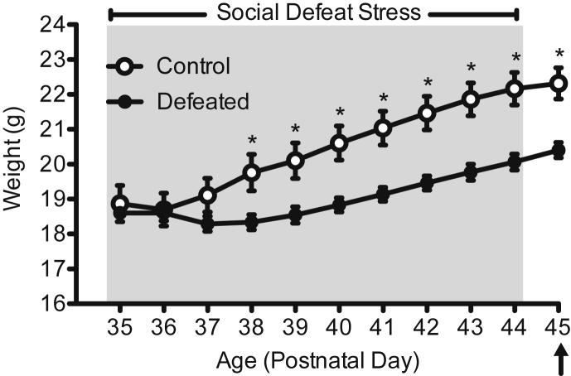
Figure 2 Effects of social defeat stress on body weight in adolescent male C57BL/6 mice
Notes:
Social defeat (postnatal day 35–44; gray area) reduced overall body weight across days of stress, starting on day 4 of stress exposure (postnatal day 38), when compared to non-stressed controls (n = 24). Body weight remained significantly lower in the defeated group (n = 31) 24 h after the last day of stress exposure (postnatal day 45). Arrow indicates day of behavioral testing and brain tissue collection. *Significantly different when compared to controls (p < 0.05). Data are presented in grams (mean ± SEM).

Slide 15
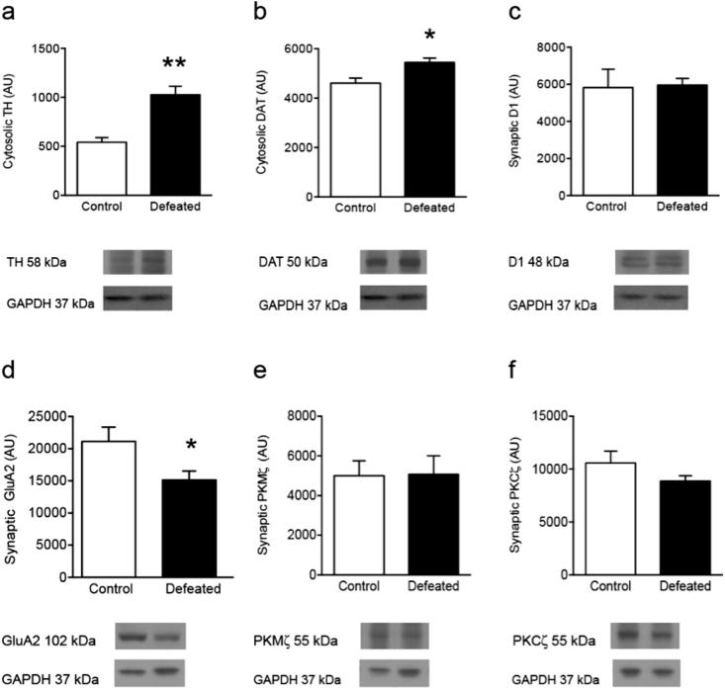
Figure 3 Effects of social defeat stress on hippocampal dopamine- and GluA2-related function in adolescent male C57BL/6 mice
Notes:
(A) Social defeat stress increased cytosolic tyrosine hydroxylase (TH), when compared to controls (∗∗p < 0.01). (B) Similarly, social defeat stress increased cytosolic dopamine transporter (DAT) levels, when compared to controls (∗p < 0.05). (C) No differences in synaptic dopamine-1 receptors (D1) were observed between the groups (p > 0.05). (D) Conversely, social defeat stress reduced synaptic GluA2 when compared to controls (∗p < 0.05). (E–F) No differences in synaptic PKMζ or PKCζ were evident following social defeat stress (p > 0.05). Arbitrary units (AU). Data are presented as ratio of total protein normalized to GAPDH (mean + SEM).

Slide 16
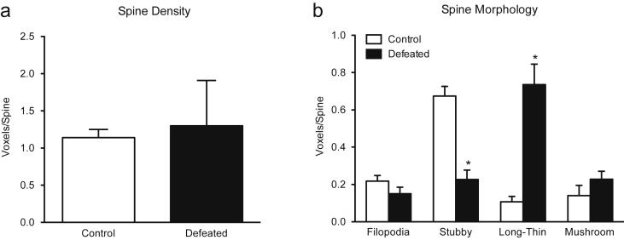
Figure 4 Effects of social defeat stress on spine density and morphology within the CA1 of the adolescent hippocampus in male C57BL/6 mice
Notes:
(A) Social defeat did not alter overall spine density as a function of stress (p > 0.05). (B) Conversely, when assessing spine morphology, social defeat significantly decreased stubby spines (p < 0.01), and increased long-thin spines (p < 0.01), while having no effect on filopodia (p > 0.05) or mushroom spines (p > 0.05). Data are presented as voxels per micron (mean + SEM).

Slide 17
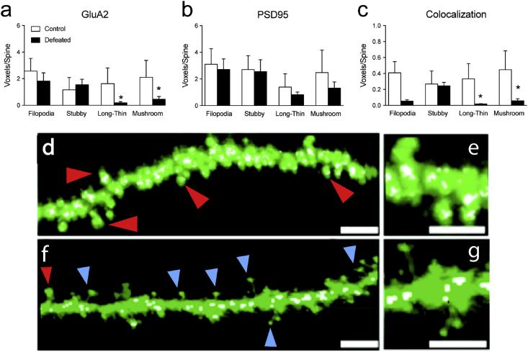
Figure 5 Effects of social stress on GluA2, PSD95, and their colocalization across spine types in the CA1 region of the hippocampus in adolescent C57BL/6 male mice
Notes:
Social defeat stress decreased (A) GluA2 expression within long-thin and mushroom spines (*p < 0.05). (B) No changes in PSD95 were observed across spine types (p > 0.05) as a function of stress exposure. Conversely, (C) the number of spines expressing the colocalization of GluA2 and PSD95 was reduced in long-thin and mushroom spines (*p < 0.05). Representative images of a dendritic branch from a control (D–E) and socially defeated animal (f–g). Scale bar = 5 μm for d and f; 2.5 μm for e and g. Red arrows indicate stubby spines. Blue arrows indicate long-thin spines. White voxels represent GluA2/PSD95 colocalization. Data are represented as mean voxels per spine (mean + SEM). (For interpretation of the references to colour in this figure legend, the reader is referred to the web version of this article.)

Slide 18
Summary
Social defeat stress induces a depression-like behavioral response in adolescent C57BL/6 male mice
Defeated mice were 2g lighter than controls on average
Social defeat stress increased cytosolic tyrosine hydroxylase (TH) and cytosolic dopamine transporter (DAT)
Reduced synaptic GluA2
No differences in synaptic dopamine-1 receptors (D1)
Social defeat significantly decreased stubby spines
Increased long-thin spines
No effect on filopodia or mushroom spines

Slide 19
Hyer, M. et al. (2017) Separation increases passive stress-coping behaviors during forced swim and alters hippocampal dendritic morphology in California mice

Slide 20
Methods
60-90 day California mice (virgins allowed to breed)
Only half the males were allowed to stay past PND 1
Forced Swim Test
1 test
2 hours after lights out under red light illumination
5 minutes
2 minute habituation
3 minute test

Slide 21
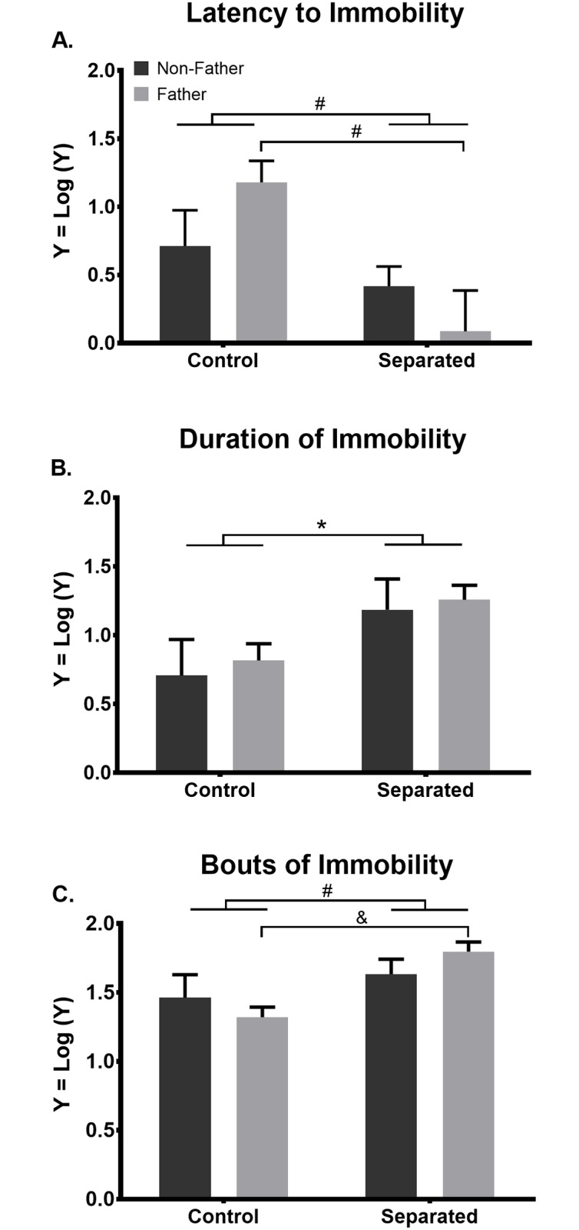
Figure 1 Separation increases passive stress-coping behavior during the forced swim task in male California mice
Notes:
(A) Twenty days of separation, regardless of paternal experience, significantly shortens the latency to the initial bout of immobility during the forced swim task, compared to non-separated controls. Among paternal mice, separation from offspring exacerbates this effect, as separated fathers have a shorter latency to immobility than non-separated fathers. (B) Regardless of paternal experience, 20 days of separation increases the duration of immobility during the forced swim task. (C) Twenty days of separation, regardless of paternal experience, increases bouts of immobility during the forced swim task, compared to non-separated controls. Among paternal mice, separation from offspring exacerbates this effect as separated fathers have more bouts of immobility than non-separated fathers. *p ≤ 0.05, #p ≤ 0.01, &p ≤ 0.001. Bars represent mean + SEM.

Slide 22
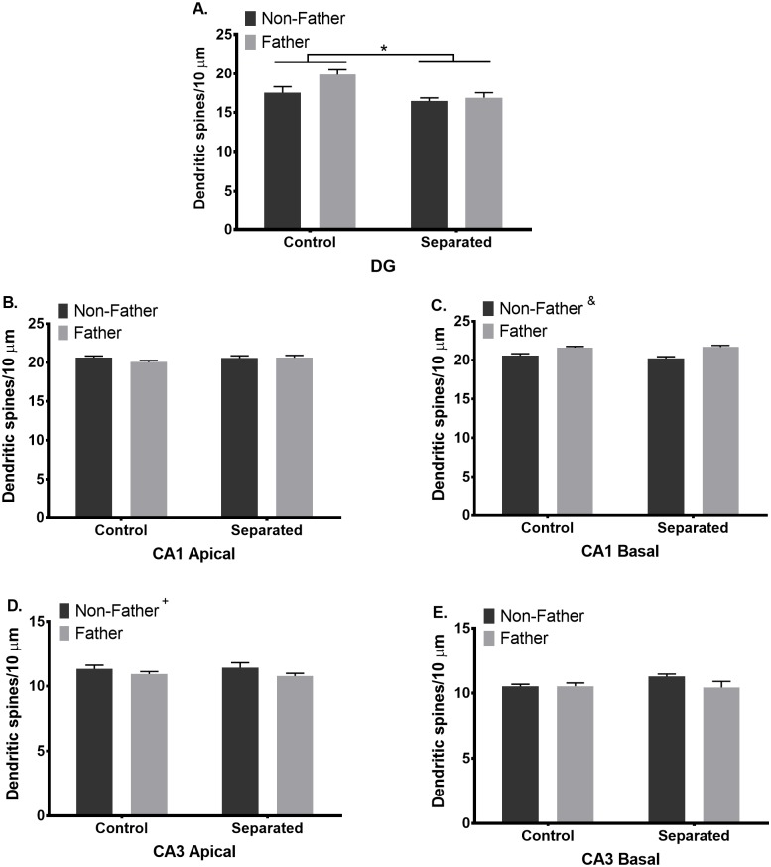
Figure 2 Separation and fatherhood have hippocampal subfield-specific effects on dendritic spine density in California mouse fathers
Notes:
A) Separation from mate and/or offspring decreases dendritic spine density of dentate gyrus (DG) granule cells, compared to control males. *p ≤ 0.05. (B) Neither paternal experience nor separation alters dendritic spine density of CA1 apical pyramidal cells. (C) Paternal experience increases spine density on CA1 basal dendrites, but (D) decreases spine density of CA3 apical dendrites +p ≤ 0.05, non-fathers compared to fathers, &p 0.001, non-fathers compared to fathers. (E) Neither paternal experience nor separation alters dendritic spine density of CA3 basal pyramidal cells. Bars represent Mean + SEM.

Slide 23
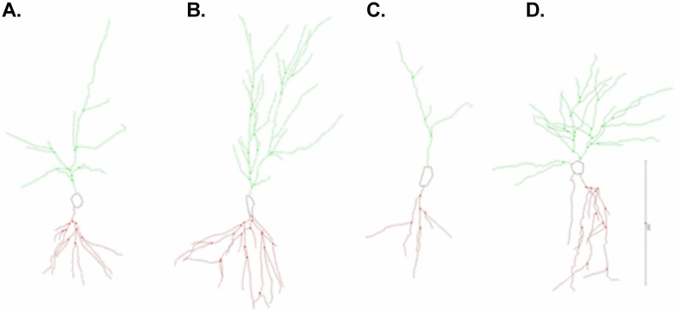
Old figure 3

Slide 24
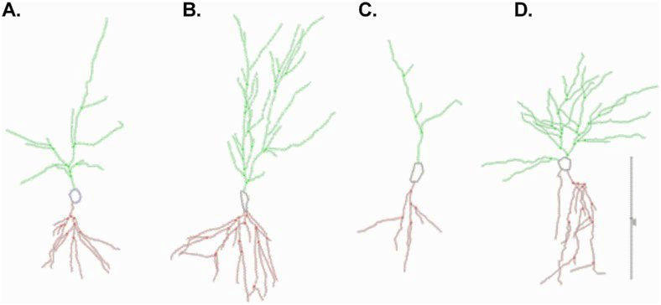
Figure 3 Microlucida tracings of Golgi-impregnated CA1 pyramidal cells
Notes:
Actually neurolucida from MBF Bioscience. Representative tracings of a (A) control non-father, (B) control father, (C) separated non-father, and (D) separated father. Scale bar = 200 μm.

Slide 25
Table 1 Separation and paternal experience alters dendritic spine density in areas CA1, CA3, and the DG of the hippocampus in California mice
Notes:
DG: difference in separation (reduced density) and paternal experience
CA1 apical: no main effect
CA1 basal: fathers slight increase
CA3 apical: fathers slight decrease
CA3 basal: no main effect

Slide 26
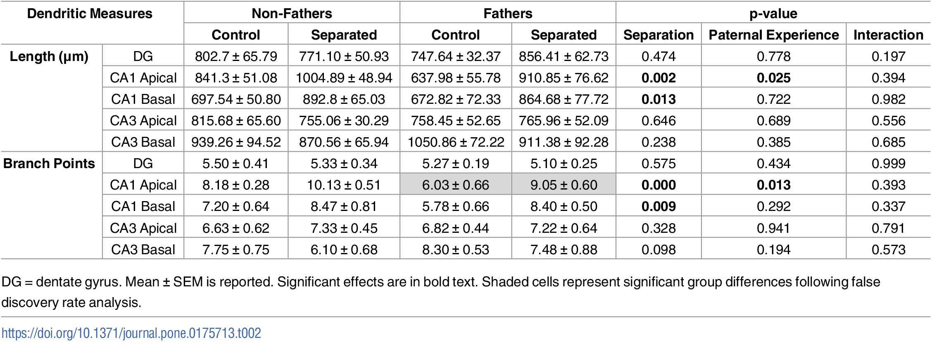
Table 2 Separation and paternal experience alter dendritic tree complexity in CA1, but not DG or CA3, of the hippocampus in California mice
Notes:
Length
DG: no main effect
CA1 apical: separation increased, control father decreased
CA1 basal: separation increases
CA3 apical: no main effect
CA3 basal: no main effect
Branch points
DG: no main effect
CA1 apical: separation increased, control father decreased
CA1 basal: separation increases
CA3 apical: no main effect
CA3 basal: no main effect

Slide 27
Summary
CA1 neurons are affected
CA1 function is memory retrieval
Potential deficit?
Increased bouts of immobility during the forced swim task, compared to non-separated controls
Fathers showed more dramatic increases of immobility
Spine Density
DG: difference in separation (reduced density) and paternal experience
CA1 apical and CA3 basal: no main effect
CA1 basal: fathers slight increase
CA3 apical: fathers slight decrease
Length and Branch Points
DG: no main effect
CA1 apical: separation increased, control father decreased
CA1 basal: separation increases
CA3 apical: no main effect
CA3 basal: no main effect

Slide 28
García-Rojo, G. et al. (2017) The ROCK Inhibitor Fasudil Prevents Chronic Restraint Stress-Induced Depressive-Like Behaviors and Dendritic Spine Loss in Rat Hippocampus

Slide 29
Methods
Sprague-Dawley rats
Restraint Stress
Controls injected with saline every day for 18 days
Experimental groups injected with 10mg of Fasudil 15 prior to the protocol
2.5 hours per day for 14 days between 9-12pm
Forced Swim Test
24 hours after last restraint test
1 training day (15 minutes)
14 test days (5 minutes)

Slide 30
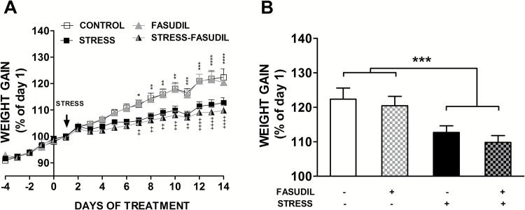
Figure 1 Effect of chronic restraint on body weight gain
Notes:
(A) The graph represents mean ± SEM of the change in body weight as a percentage of the initial weight for control animals that were left untreated (CONTROL, n=16) or treated with Fasudil (FASUDIL, n=13), untreated animals subjected to chronic restraint stress (STRESS, n=16) and Fasudil-treated animals subjected to chronic restraint (STRESS-FASUDIL, n=15). Two-way ANOVA followed by Tukey’s post-hoc analysis. CONTROL vs STRESS *P <.05, **P<.01, ***P<.001, ****P<.0001. FASUDIL vs STRESS-FASUDIL ++P<.01, +++P < .001, ++++P < .0001. (B) Variation of body weight gain was evaluated at the endpoint of treatments. Two-way ANOVA, ***P<.001.

Slide 31
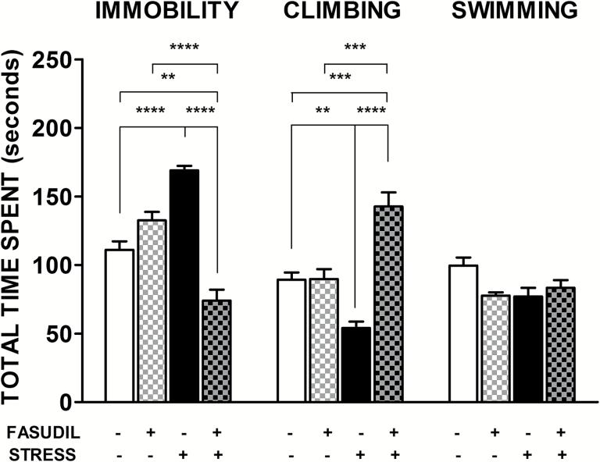
Figure 2 Effects of Fasudil administration on immobility and active response duration in the forced swimming test (FST)
Notes:
Bar graph indicates mean ± SEM of total time spent in immobility and climbing behaviors. Two-way ANOVA followed by Tukey’s post-hoc analysis indicated that Fasudil-treated animals (FASUDIL, n= 5) showed similar durations of immobility and active behaviors as animals injected with saline (CONTROL, n = 7). Stressed animals (STRESS, n = 7) spent more time in an immobile posture and significantly reduced climbing behavior. Chronic treatment with Fasudil (STRESS-FASUDIL, n=6) prevented the stress-induced immobility by increasing active behaviors, mainly in the form of climbing. **P < .01; ***P < .001; ****P < .0001.

Slide 32
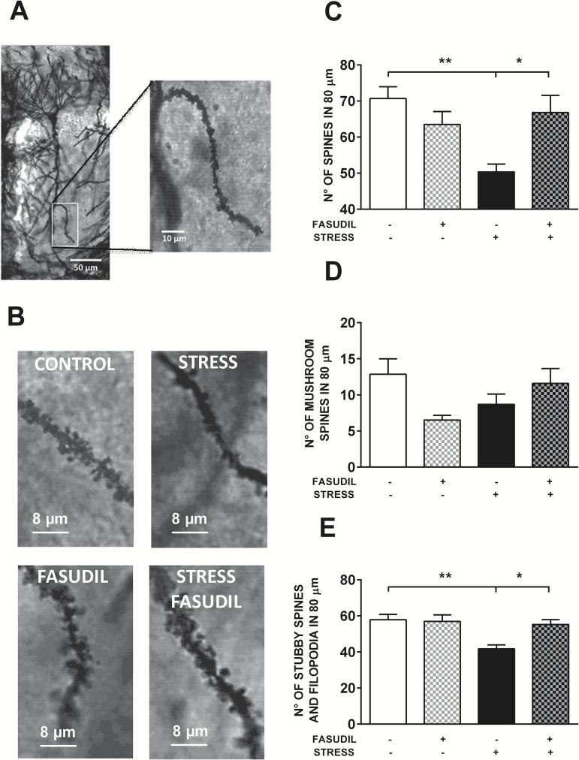
Figure 3 Effects of stress and Fasudil treatment on spine number along apical dendrites of pyramidal neurons in the CA1 hippocampal region
Notes:
(A) The photograph shows a representative isolated Golgi-stained pyramidal neuron of the CA1 hippocampal region of control animals, and a magnification of a secondary dendritic branch in the stratum radiatum area, which was used to count spines. (B) Photographs show the qualitative effects of stress and Fasudil treatment on spine density from a secondary dendrite. (C) Effect of treatments on total spine number in a dendritic segment of 80 µm. Two-way ANOVA followed by Tukey’s post-hoc analysis revealed that stress induced a reduction in spine density and that Fasudil prevented the stress-induced reduction in spine density. (D) Effect of treatments on mushroom spine number in a dendritic segment of 80 µm. (E) Effect of treatments on nonmushroom spine number in a dendritic segment of 80 µm. Two-way ANOVA followed by Tukey’s post-hoc analysis indicated that stress induced a reduction in spine density and that Fasudil prevented the stress-induced reduction in spine density. Values are the mean ± SEM (CONTROL, n = 5; FASUDIL, n = 4; STRESS, n = 5; STRESS-FASUDIL, n = 5). *P < .05; **P < .01.ol

Slide 33
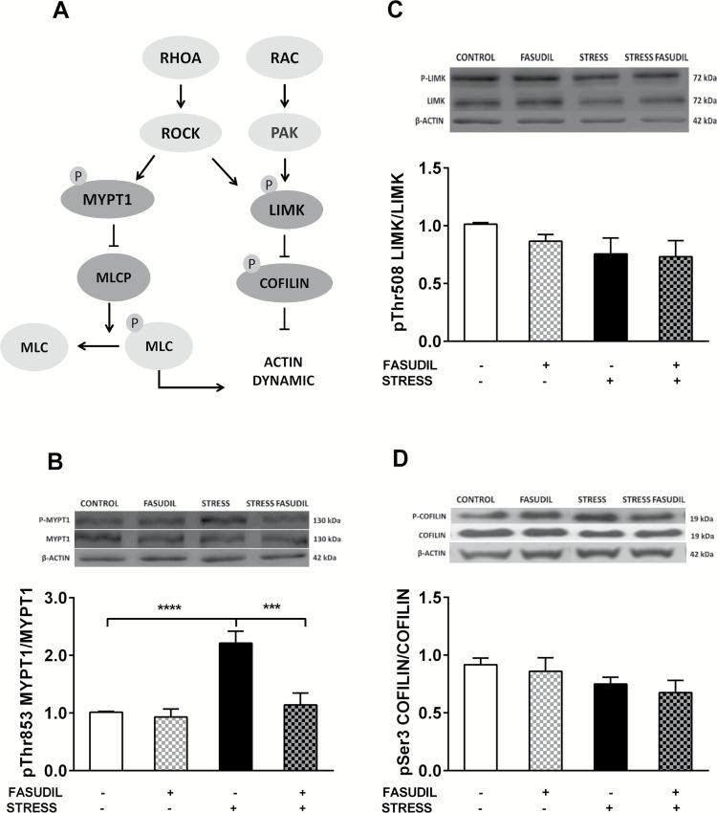
Figure 4 Effect of stress and Fasudil on the phosphorylation state of proteins related to actin dynamics, myosin phosphatase targeting subunit 1 (MYPT1), LIMK, and cofilin
Notes:
(A) Pathways related to RAC and RhoA activation and their downstream effectors. (B) phospho-MYPT1 expressed as a ratio of phospho-MYPT1 relative to MYPT1. Two-way ANOVA followed by Tukey’s post-hoc analysis indicated an increase in p-MYPT1 levels that was prevented by Fasudil. (CONTROL n = 7; FASUDIL n = 5; STRESS n = 6 and STRESS-FASUDIL n = 5). ***P < .001, ****P < .0001 (C) phospho-LIMK expressed as a ratio of phospho-LIMK relative to LIMK. (CONTROL n = 5; FASUDIL n = 4; STRESS n = 5 and STRESS-FASUDIL n = 4). (D) phospho-cofilin expressed as a ratio of phospho-cofilin relative to cofilin (CONTROL n=6; FASUDIL n=5; STRESS n = 6 and STRESS-FASUDIL n = 5). β-Actin was used as the loading control. Values are the mean ± SEM.

Slide 34
Summary
Fasudil
Decreases weight gain
Least amount of time immobile, most time climbing (FST)
Restores spine density to a more normal range
Prevented an increase in p-MYPT1 levels

Slide 35
My Questions
What effects do depression and stress have on our neurons?
Decreased spines and dendrite length in some cases
Is there a difference in these effects if familial separation is the stressor?
Yes
If there is a difference, is there a way to counteract it?
Drugs like Fasudil show potential in ways to counteract the neurobiological effects of stress and depression

